Slide 1
Building a Bw-Tree Takes More Than Just Buzz Words
Conference : SIGMOD ' 18
Author : Ziqi Wang, Andrew Pavlo, Hyeontaek Lim, Viktor Leis, Huanchen Zhang, Michael Kaminsky, David G. Andersen
Research unit : Carnegie Mellon University, Intel Labs

Slide 2
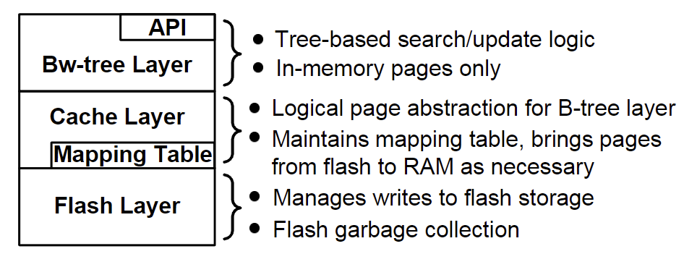
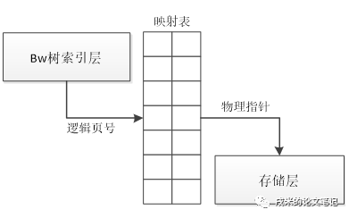
Background
Bw-Tree
Bw-Tree is a new index structure designed for high-performance transactional systems, introduced by Microsoft Research in 2013. The Bw-Tree structure is a type of B-tree that is designed to minimize the number of disk accesses required to read or modify data. The key innovation of the BW-Tree is the use of latch-free algorithms and wait-free data structures to reduce contention and improve concurrency.
Notes:
Bwtree是微软在2013年发表的数据结构，主要实现了无锁的数据结构
Bw-tree Layer
维护在内存中的page，并把page组织成一棵树；
提供对这个树形结构的page的访问接口，search和update。
Cache Layer
把Bw-tree layer的page的抽象成逻辑页面，逻辑页面通过PID定义，提供给上层的B-tree使用，注意：B-tree节点链接的不是page，而是逻辑页面，即PID。
维护了一个Mapping Table，Mapping Table维护了逻辑页面和物理页面的映射，管理物理页面在内存和磁盘上的换入换出。
Flash Layer：
实现了log-structure storage。存储系统的性能一般受限于磁盘的IO性能，特别是IOPS，Flash Layer实现的LSS实现了写大块数据，避免了磁盘去填充字节对齐，提升磁盘性能。
实现了磁盘垃圾数据的逻辑回收。

Slide 3
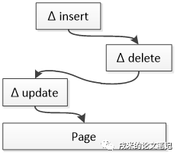
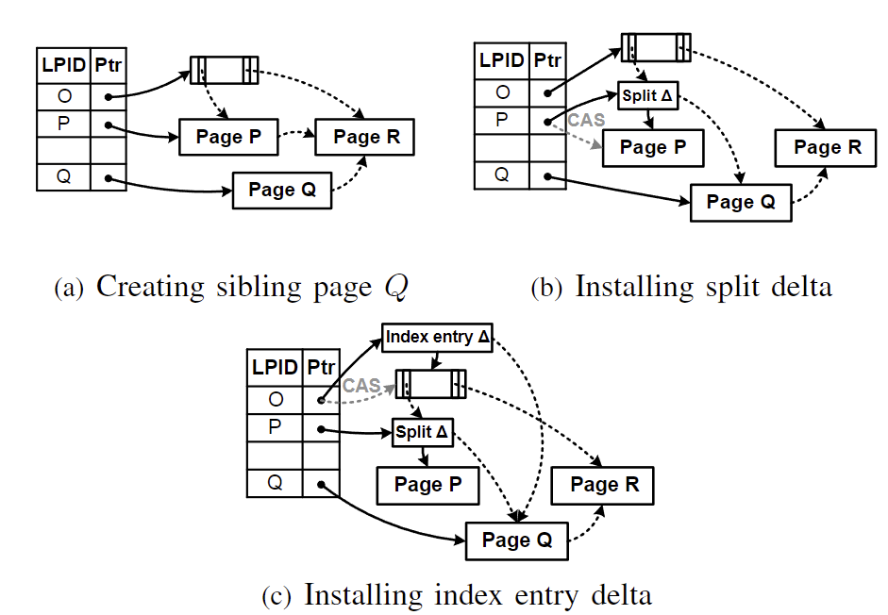
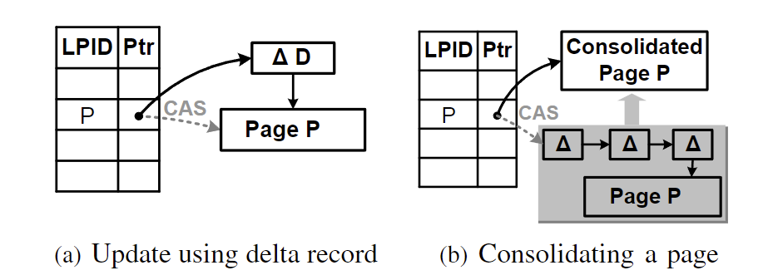
Background
Page updates
Split example
Page

Slide 4
Problem
Missing implementation details
The original paper lacks detailed descriptions of critical components and runtime operations. For example, they do not provide a scalable solution for safe memory reclamation or efficient iteration. Microsoft's Bw-Tree may support these features, but the implementation details are unknown.

Slide 5
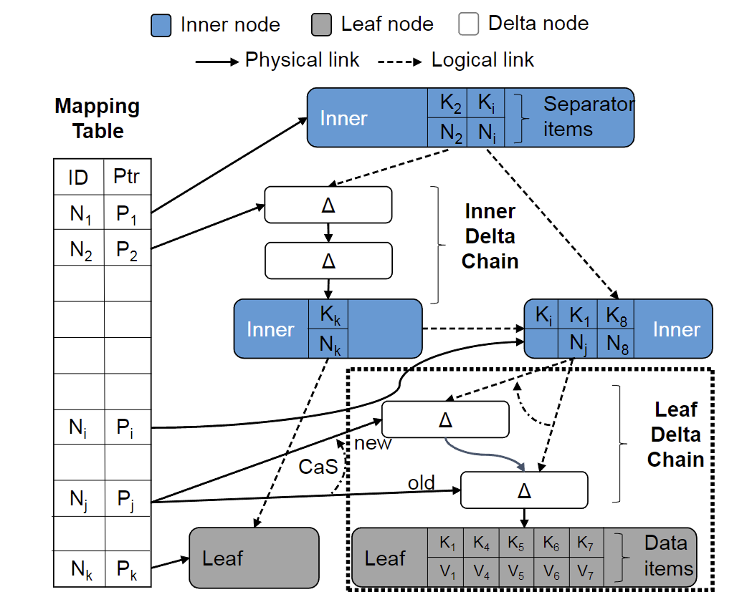
Solution
Architecture Overview
Every node in the Bw-Tree has a unique logical node ID (64-bit).
Instead of using pointers, nodes refer to other nodes using these IDs
When a thread needs the physical location of a node, it consults the Mapping Table to translate a node ID to its memory address.
There are two types of base nodes:
an inner base node that holds a sorted (key, node ID) array
a leaf base node that holds a sorted (key, value) array
Notes:
CAS 操作包含三个操作数 —— 内存位置（V）、预期原值（A）和新值(B)。如果内存位置的值与预期原值相匹配，那么处理器会自动将该位置值更新为新值。否则，处理器不做任何操作。无论哪种情况，它都会在 CAS 指令之前返回该位置的值。

Slide 6
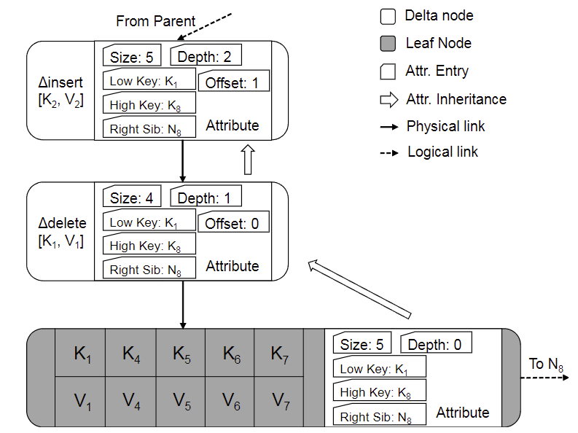
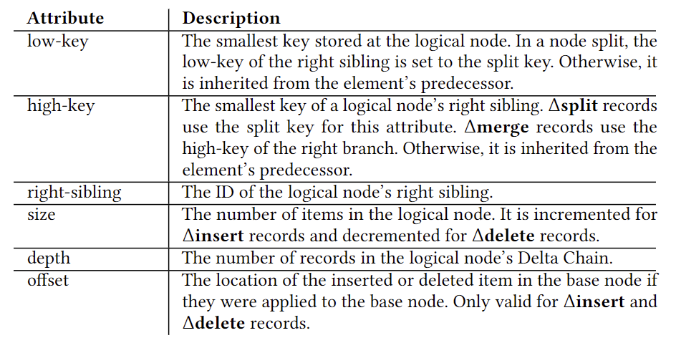
Solution
Delta Records Overview
Notes:
如图2所示，Delta Chain是一个单链表，其中包含对基本节点所做修改的按时间顺序排列的历史记录。Delta Chain中的条目使用物理指针连接，尾部指向基本节点。基本节点和它的增量记录都包含表示该时间点逻辑节点状态的额外元数据(参见表1)。也就是说，当一个工作线程更新一个逻辑节点时，它们会计算逻辑节点的最新属性并将它们存储在增量记录中。然后，线程在导航树或执行结构修改时使用这些信息，以避免不得不遍历(和重放)节点的Delta Chain。
映射表中节点的逻辑链接指向Delta Chain条目或基本节点。线程将新条目追加到节点的Delta Chain头，然后更新映射表中的物理地址。

Slide 7
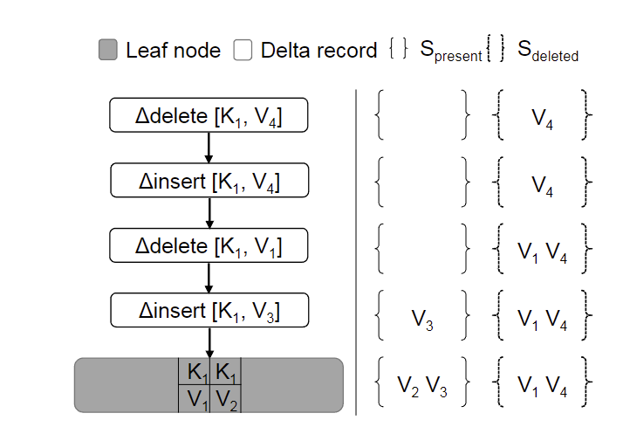
Technique
Non-unique Key Support
The first set (S_{present} ) contains the values that are already known to be present.
The second set (S_{deleted} ) contains the values that are known to be deleted.
If a worker thread finds an insert delta record with key K and value V where V ∉ S_{deleted} , it adds V to S_{present}.
If the thread finds a delete delta record with key K and value V where K ∉ S_{present} , it adds V to S_{deleted} .

Slide 8
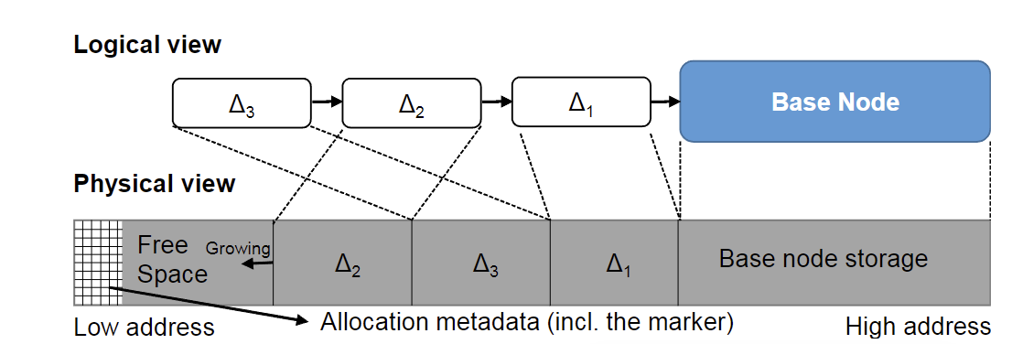
Technique
Delta Record Pre-allocation
The Delta Chain in Bw-Tree is a linked list of delta records that is allocated on the heap. Traversing this linked list is slow because a thread can incur a cache miss for each pointer dereference.
Excessive allocations of small objects create contention in the allocator, which becomes a scalability bottleneck as the number of cores increases.
OpenBw-Tree pre-allocates the delta records inside of each base node.
Each chain also maintains an allocation marker that points to the last delta record or the base node.
If the pre-allocated area is full, then this triggers a node consolidation.
Slot allocations and Delta Chain appendings are not atomic, permitting multiple threads to interleave them.
Notes:
delta结构一般在堆上申请，在遍历delta链时不可避免会产生一些cache miss，并且delta体积不大，多线程频繁申请内存会成为性能瓶颈。
为了应对这一问题，如图4，OpenBw-Tree在base node相邻的低地址处预申请了一定量将要应用在该base node上的delta结构。从高地址到低地址，每次需要delta结构时都会从这部分空间中去取。这样遍历delta链时，因为先遍历到的delta结构是后申请的，所以大致上是按从低地址到高地址的连续内存空间中访问内存。预先做cache prefetch载入所有delta结构，这样就不会再有cache miss的问题，大大提升性能。

Slide 9
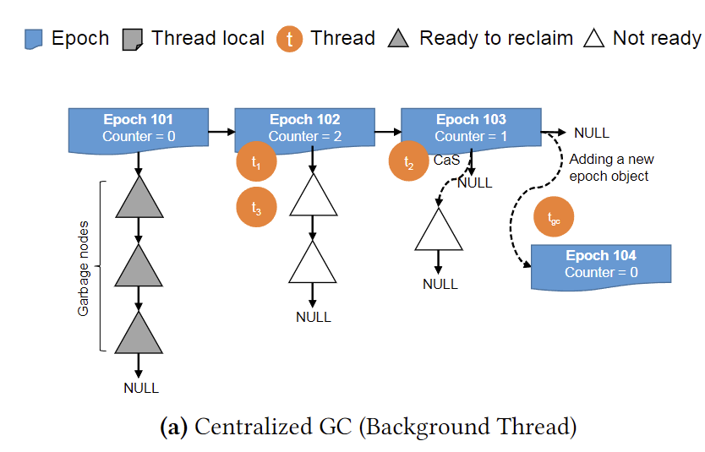
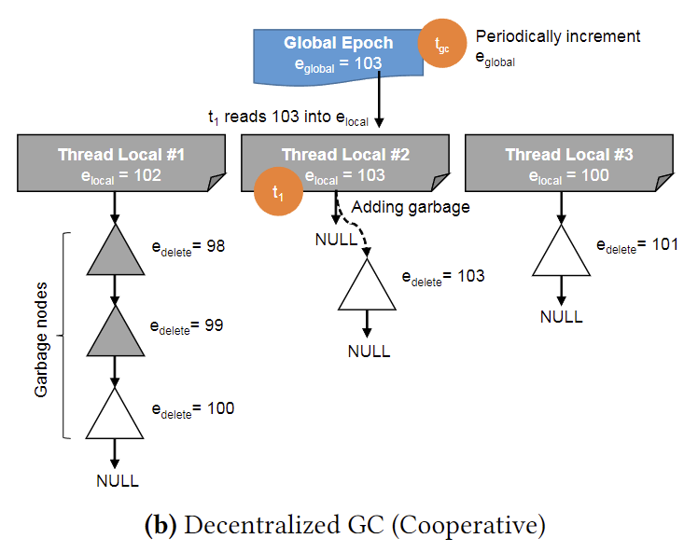
Technique
Epoch-based reclaim
The index maintains a list of global epoch objects, and appends new epoch objects to the end of this list at fixed intervals.
Every thread must enter the epoch by enrolling itself in current epoch before it accesses the index's internal data structures.
When the thread completes its operation, it removes itself from the epoch it has entered.
Any objects that are marked for deletion by a thread are added into the garbage list of the current epoch.
Once all threads exit an epoch, the index's GC component can reclaim the objects marked for deletion in that epoch.
This becomes bottleneck when there are many threads because of cache coherence traffic.
Notes:
原始Bw-Tree[25]的基于时代的GC方案提供了安全的内存回收，可以防止索引在可能存在正在访问内存的线程时重用内存。使用这种方法，索引维护一个全局epoch对象的列表，并以固定的间隔(例如，每40毫秒一次)将新的epoch对象追加到该列表的末尾。每个线程在访问索引的内部数据结构(例如，执行键查找)之前，必须通过在当前epoch对象中注册自己来进入epoch。当线程完成它的操作时，它将自己从它所进入的纪元中删除。任何被线程标记为删除的对象都被添加到当前纪元的垃圾列表中。一旦所有线程退出一个epoch，索引的GC组件就可以回收该epoch中标记为删除的对象。
图5a说明了具有三个活动时段、三个工作线程(t1, t2, t3)和一个后台GC线程(tдc)的集中式GC方案。在这个图中，t2将一个新节点添加到纪元103的垃圾列表中。同时，GC线程tдc将一个新的epoch对象安装到epoch列表中。由于新纪元101内的计数器已达到零，tдc将回收其垃圾列表中的所有条目。
这种集中式GC实现的可伸缩性很差，因为工作线程通过递增表示当前epoch[33]中的活动线程数量的计数器来注册新纪元。当有很多线程时，这就成为瓶颈，因为缓存一致性流量[34]。所有线程都要访问全局内存空间
存在一个全局的时钟Eglobal，另外各个线程还有单独的Elocal，外加该线程私有的待回收内存结构链表Llocal，各待回收内存结构中包含该线程将其插入到链表时的Eglobal值Edelete。
Eglobal由单独线程定时递增
在线程完成操作时会将Elocal设为Eglobal，并启动GC：该线程会查看所有其他线程并比较得出他们Elocal的最小值Emin，在自己的链表中找到小于Emin的回收。

Slide 10
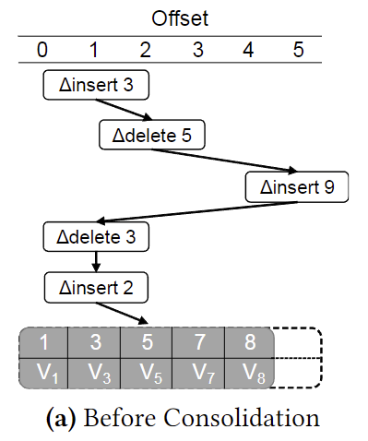
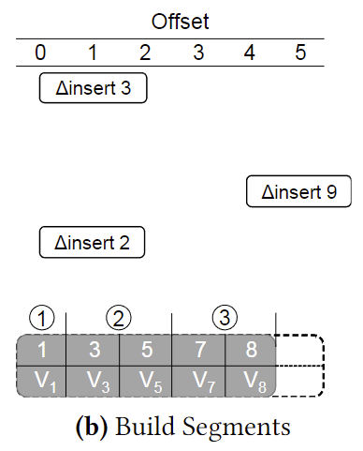
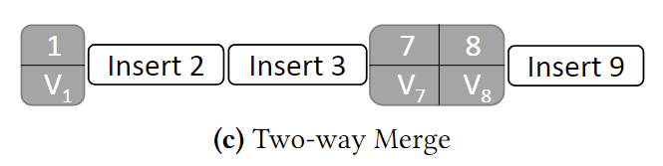
Technique
Fast Consolidation
Reuses the Delta Chain replay technique of non-unique key support to gather effective changes to the base node.
The OpenBw-Tree divides the old base node's item array into segments using the offset field in delta records. The thread first sorts all items in S_{present} and S_{deleted} by their offsets and keys and applies the following rules:
Rule #1: For an inserted item, an existing segment [s,e) is broken into the segments [s,offset) and [offset,e).
Rule #2: For a deleted item, an existing segment [s, e) is broken into the segments [s, offset) and [offset +1, e).
Rule #3: However, if a delete delta removes an item that does not exist in the base node (i.e., deleting an item that is newly inserted by an earlier delta), the thread ignores this deletion.
Notes:
将delta链和base node做逻辑合并产生新节点的基本方法是以base node为基础，由旧至新逐个应用delta，最终产生新的node。但这一过程耗费较高，OpenBw-Tree使用了一个较为简单的处理方法。
复用“重复key查询支持”中的Spresent和Sdeleted机制，只是这两个集合不再只针对某个key，而是针对所有key，即分别表示遍历delta链到当前位置确定存在和不存在的(k,v)集合。
针对每个delta，确定其offset值：对于insert delta，表示的是它应用于base node，其(k,v)会出现的位置，如图中delta insert 3，offset为2；对于delete delta，表示的是它所要删除的(k,v)在base node上所处的位置，如图中 delta delete 5，offset为2。这两类delta会把base node上的(k,v)划分为多个区段，最终，我们可以将这些区段同Spresent中的insert delta做2路归并，得到新的节点。
这种方法主要是消除了原始方法中对base node数据的插入和删除，最终通过一个简单的归并得到最终结果。

Slide 11
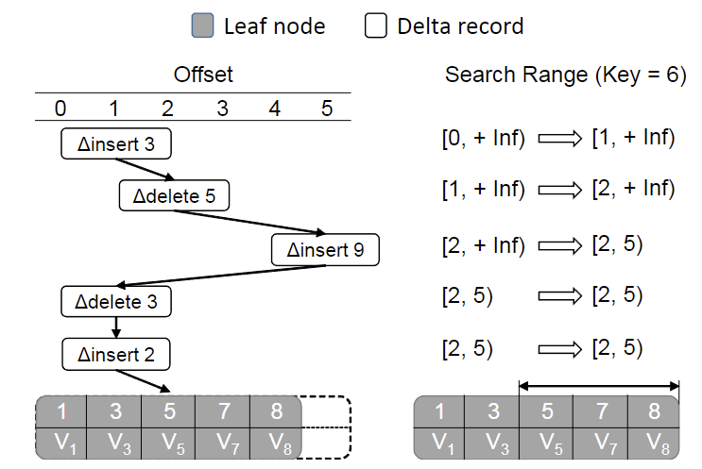
Technique
Node Search Shortcuts
When a worker thread traverses a Delta Chain, it initializes the binary search range [min, max] it accesses for search key K to [0, +inf).
During the traversal, whenever the thread sees an ∆insert or ∆delete record with key K′ and offset, it compares K with K′. If K=K′ then the range immediately converges to [offset, offset ], avoiding the binary search.
If offset > min and K>K′, then set min to offset. Otherwise, if offset < max and K<K ′ then set max to offset.
Notes:
如果基本节点跨越多个高速cache line,则二分搜索的前几个探测可能会导致高速缓存未命中
上述delta的offset还有加速base node搜索的作用。insert delta中的offset表示的是其key插入到base node中的位置。对于目标搜索key，可以通过比较它和delta中的key，来确定其在base node上的位置边界，缩小最终在base node上的搜索范围。
如图7，搜索key=6，遍历过程中发现insert delta key = 3的offset为1，则可确定key=6在base node上的位置必然在offset=1之后，依此类推。

Slide 12
Evaluation
Setup
All of the experiments were conducted on a system with two Intel Xeon E5-2680 v2 CPUs (10 threads with 2× HT) with 128 GB RAM.
Unless stated otherwise, multi-threaded experiments run on a single CPU socket by pinning threads and restricting memory allocation to that same NUMA(Non-Uniform Memory Access) node.
Workloads
Used a set of Yahoo! Cloud Serving Benchmark (YCSB) microbenchmarks to mimic OLTP index workloads.
Used its default workloads A (Read/Update, 50/50), C (Read-only), and E(Scan/Insert, 95/5) with Zipfian distributions.
For each workload, we tested three key types: 64-bit random integers (Rand-Int), 64-bit monotonically increasing integers (Mono-Int), and email addresses (Email).
Unless otherwise stated, we configured the Bw-Tree and OpenBwTree index to enforce unique keys.
OpenBw-Tree uses a max inner node size of 64 entries and max leaf node size of 128 entries. The max Delta Chain length is 2 for inner nodes and 24 for leaf nodes.
Notes:
10核20线程
除非另有说明，多线程实验通过固定线程和限制内存分配到同一个NUMA节点在单个CPU插座上运行。
对于每个工作负载，我们测试了三种关键类型:64位随机整数(Rand-Int)、64位单调递增整数(single - int)和电子邮件地址(email)。

Slide 13
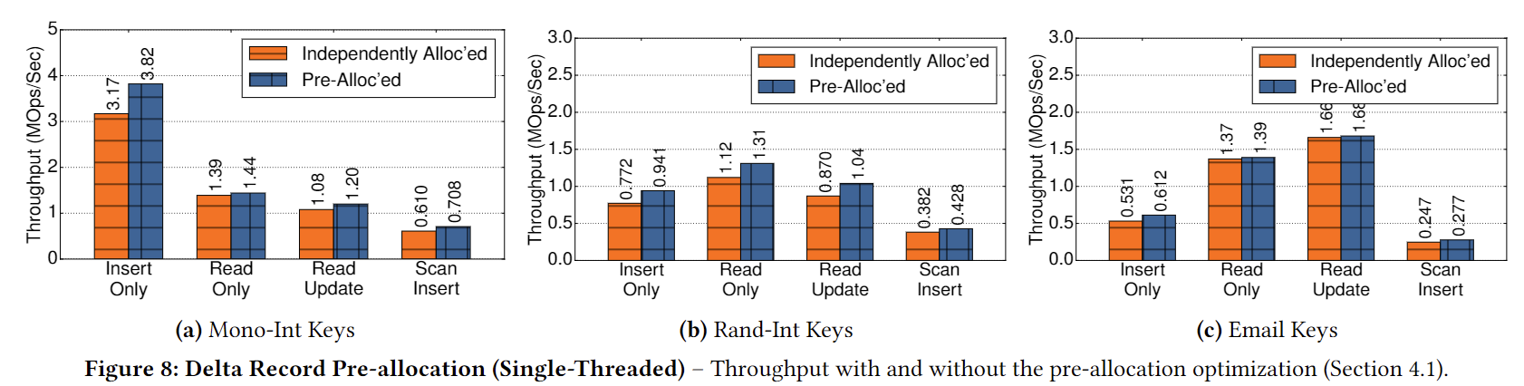
Evaluation
Delta Record Pre-allocation
The pre-allocated space on each node is set to the max Delta Chain length times the largest delta record size (176 bytes and 1728 bytes for inner and leaf base nodes, respectively).
Pre-allocation improves performance for all workloads by up to 22%.
Notes:
在第一个实验中，我们比较了预分配优化和基线方法(线程独立分配增量记录)。每个节点上的预分配空间设置为最大Delta Chain长度乘以最大Delta记录大小(内部节点和叶基节点分别为176字节和1728字节)。
图8显示了不同工作负载配置的单线程性能数字。预分配可将所有工作负载的性能提高22%。这种改进的一个原因是在Delta链遍历期间更好的局部性。

Slide 14
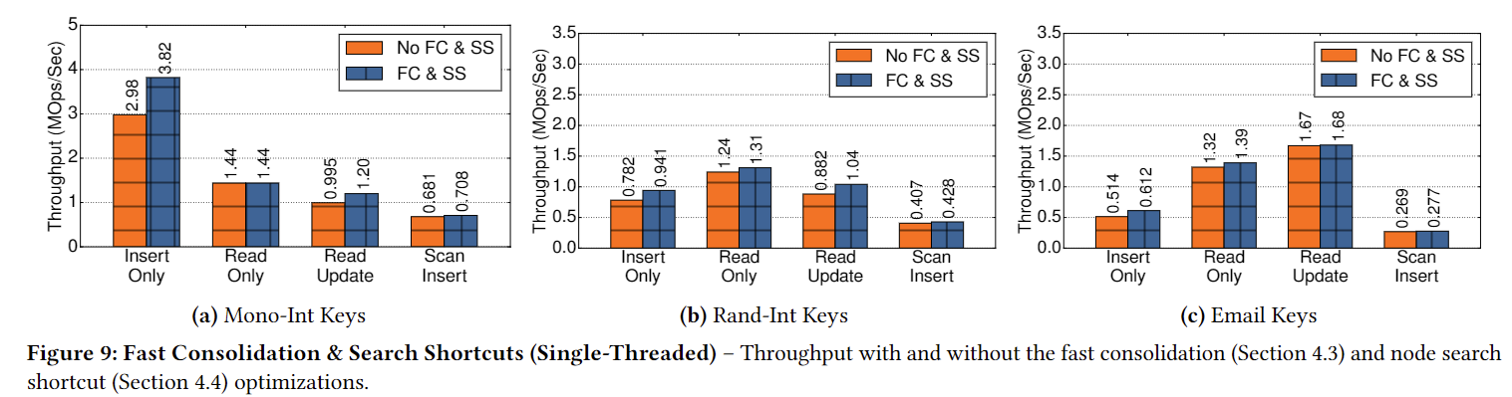
Evaluation
Fast Consolidation & Search Shortcuts
Baseline: threads sort the base node after replaying the delta chain. Threads also always search the entire leaf data item array using binary search.
For Insert-only workloads, performance increases between 19% (Email) and 28% (Rand-Int).
For Read/Update and Scan/Insert workloads, the increase is 18–20%.
Overall, fast consolidation is effective at reducing consolidation time, which increases the performance of insert-heavy workloads.
Notes:
在第一个实验中，我们比较了预分配优化和基线方法(线程独立分配增量记录)。每个节点上的预分配空间设置为最大Delta Chain长度乘以最大Delta记录大小(内部节点和叶基节点分别为176字节和1728字节)。
图8显示了不同工作负载配置的单线程性能数字。预分配可将所有工作负载的性能提高22%。这种改进的一个原因是在Delta链遍历期间更好的局部性。

Slide 15
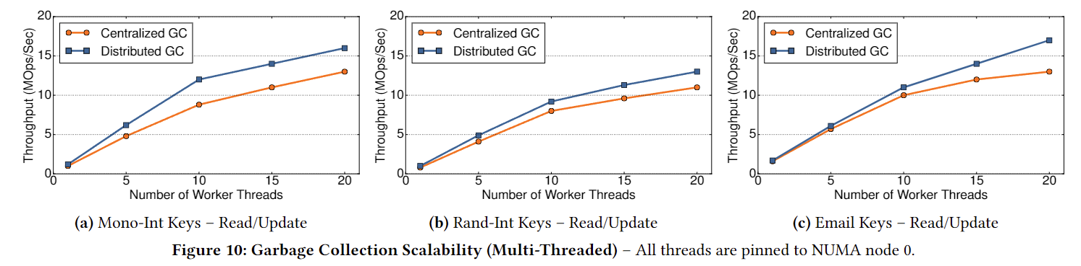
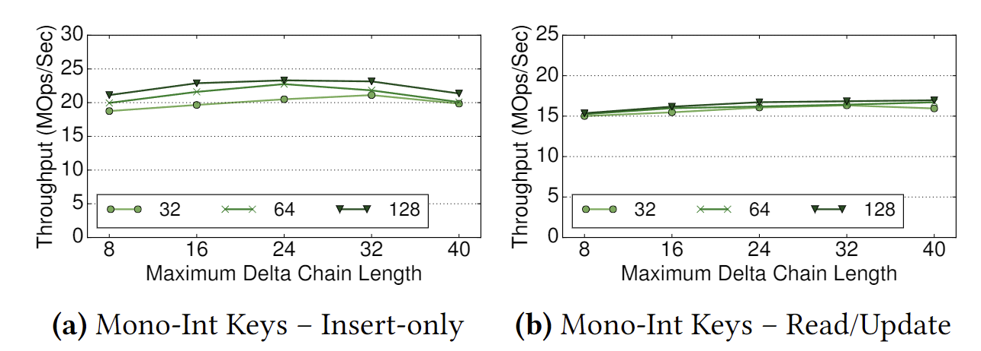
Evaluation
Garbage Collection Scalability
Delta Chain Length & Node Size
Notes:
图10显示，在高并发水平下，由于取消了集中的epoch计数器，我们改进的GC方案是优越的。与Rand-Int相比，Mono-Int键的效果更明显(20个线程提高1.3倍)，因为Mono-Int工作负载运行得更快，因此，缓存线失效更频繁地发生，因为工作线程在进入和退出索引例程时增加和减少集中的历元计数器。
我们评估了OpenBw-Tree的Delta链长度和节点大小设置如何影响其性能。前者决定在合并Delta Chain之前可以存在的记录数量，而后者决定基本节点的项数组可以存储的键-值对的数量。所有实验都使用20个工作线程运行。

Slide 16
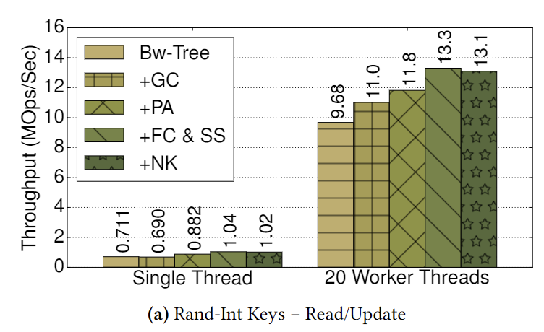
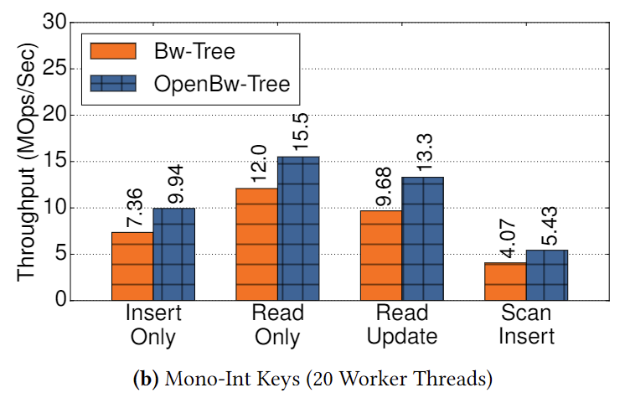
Evaluation
Optimization Summary
The left diagram shows how performance goes up as we apply each optimization to the Bw-Tree. The right diagram shows a comparison between the baseline Bw-Tree and OpenBwTree for all four workloads.
GC: Garbage Collection; PA: Pre-allocation; FC: Fast Consolidation; SS: Search Shortcut; NK: Non-unique Key Support
Notes:
为了更好地了解这些优化中的每一个的好处，我们总结了图12中以前的实验结果。图12A中的结果是将优化应用于OpenBw-Tree的改进，每次一个。我们将Rand-Int键用于使用单个和20个工作线程执行的读/更新工作负载。当只有一个线程时，预分配是最有益的优化，因为它将吞吐量提高了28%。快速合并和搜索快捷方式是第二有效的优化，速度提高了18%。如果没有重复的键，启用非唯一键支持几乎没有影响。类似的结论也适用于多线程配置。图12B显示了使用Mono-Int键的所有工作负载类型的基准BW-Tree和OpenBw-Tree之间的比较。数字是使用20个工作线程来衡量的。如图所示，我们应用于BW-Tree的优化对所有工作负载类型都同样有效，将操作速度提高了27-35%。

Slide 17
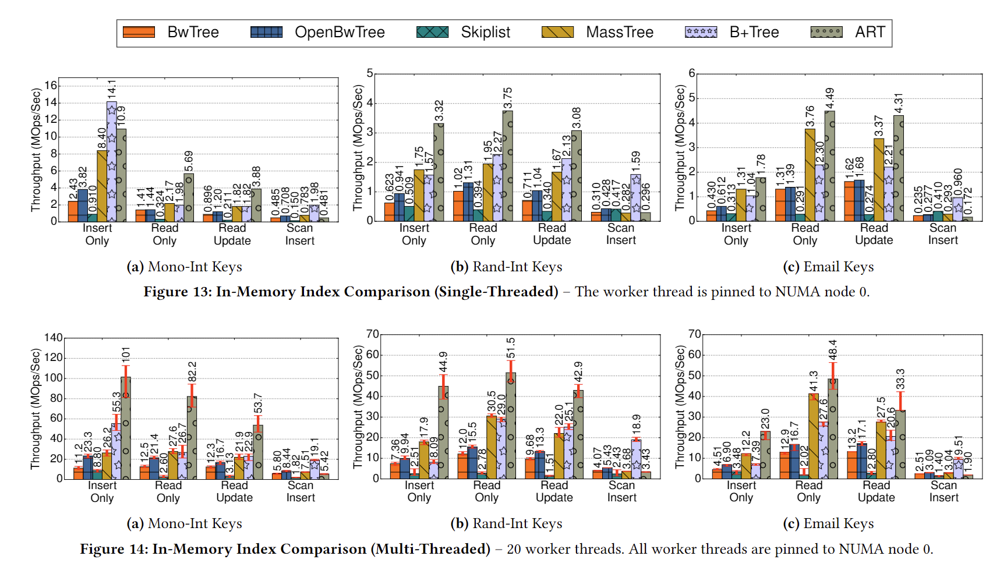
Evaluation
In-Memory Index Comparison

Slide 18
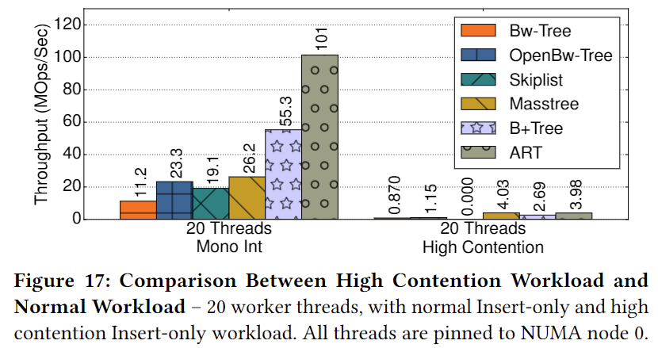
Evaluation
High Contention Workload
Lock-free data structures are often favored in high contention environments because threads can make global progress, even though the progress may be small in practice.
Each thread in the benchmark uses the RDTSC instruction with a unique thread ID suffix to generate monotonically increasing integers in real-time as keys to mimic multiple threads appending new records to the end of a table.
OpenBw-Tree suffers from an extremely high abort rate as threads contend for the head of the Delta Chain.
Notes:
Bw-Tree设计的显著特点是它是无锁的，而我们在这里测试的大多数其他数据结构都使用锁(尽管很少)。无锁数据结构通常在高争用环境中受到青睐，因为线程可以取得全局进展[30]，即使实际进展可能很小。为了更好地理解这个问题，我们创建了一个具有极端争用的专门工作负载。基准测试中的每个线程都使用带有唯一线程ID后缀的RDTSC指令来实时生成单调递增的整数作为键，以模拟多个线程将新记录添加到表的末尾。
OpenBw-Tree由于线程争夺Delta链的头部而遭受极高的中止率。表2显示中止率超过1000%，即平均每个插入有超过10个中止。

Slide 19
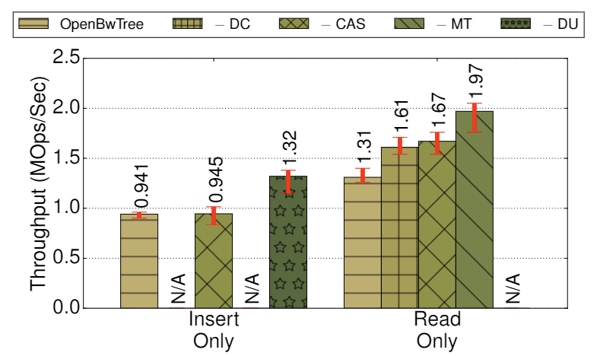
Evaluation
Bw-Tree Performance Decomposition
DC: Delta Chain; CAS: compare-and-swap; MT: Mapping Table; DU: Delta Update
Notes:
如图18所示，通过消除只读工作负载的delta chain，性能提高了23%，因为不需要replay了
禁用映射表:我们通过调用一个插入后进程，用相应的物理指针替换内部节点中的节点id，从而消除了将节点id转换为物理指针的问题。因为插入需要映射表来更新多个入站指针，所以我们只检查只读工作负载。图18的第四列展示了禁用映射表的效果。由于加载指令的缓存丢失减少，读取性能提高了18% (L1:降低32%;L3:降低52%)。

Slide 20
Conclusion
Experimental results show that OpenBw-Tree outperforms the original Bw-Tree design but is still considerably slower than other state-of-the-art in-memory index structures like SkipList, Masstree and ART.
OpenBw-Tree is also slower than a B+Tree that uses optimistic lock coupling, which indicates that lock-freedom does not always pay off in comparison with modern lock-based synchronization techniques.
Notes:
OpenBw-Tree也比使用乐观锁耦合的B+Tree慢，这表明与现代基于锁的同步技术相比，无锁并不总是有回报

